Slide 1
JAVA Lecture 10
Character Extraction and String Length

Slide 2
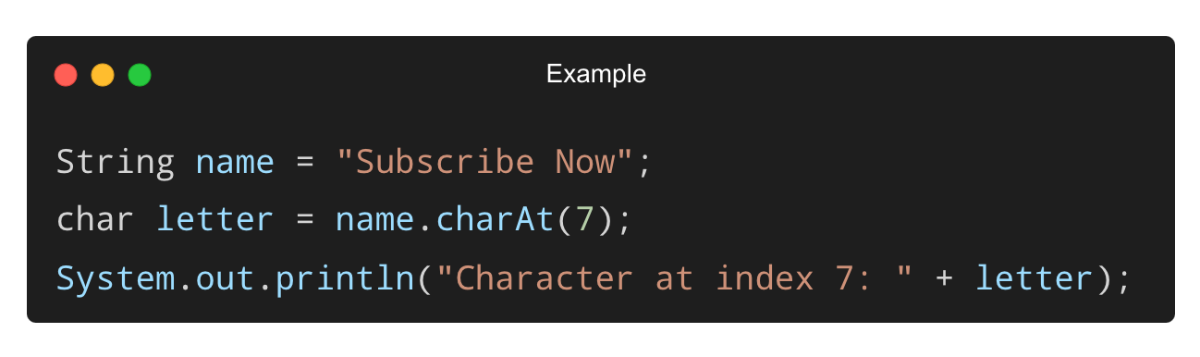
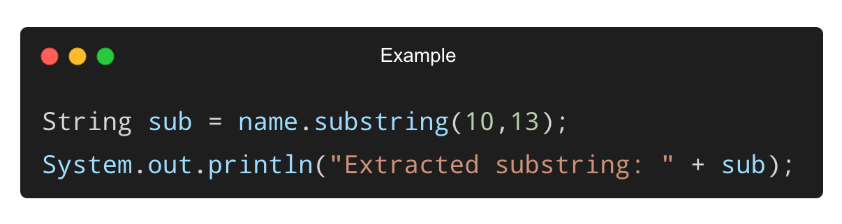
Extracting Characters from a String
Using charAt(index):
Output:
Character at index 7: b
Using substring(start, end):
Output:
Extracted substring: Now

Slide 3
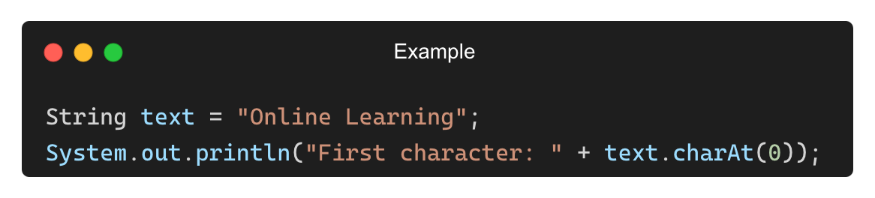
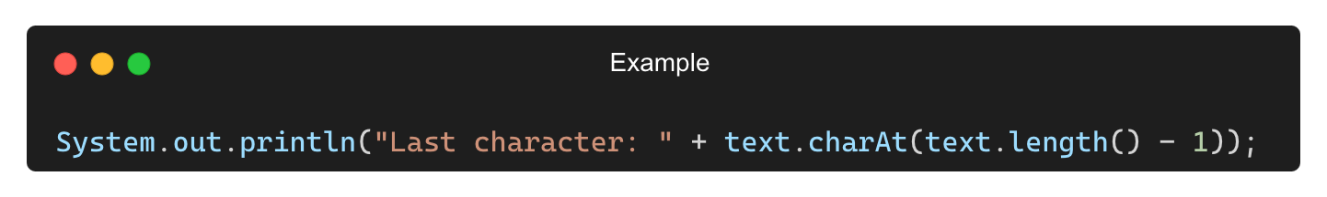
Extracting First and Last Characters
First Character:
Last Character:
Output:
First character: O
Last character: g

Slide 4
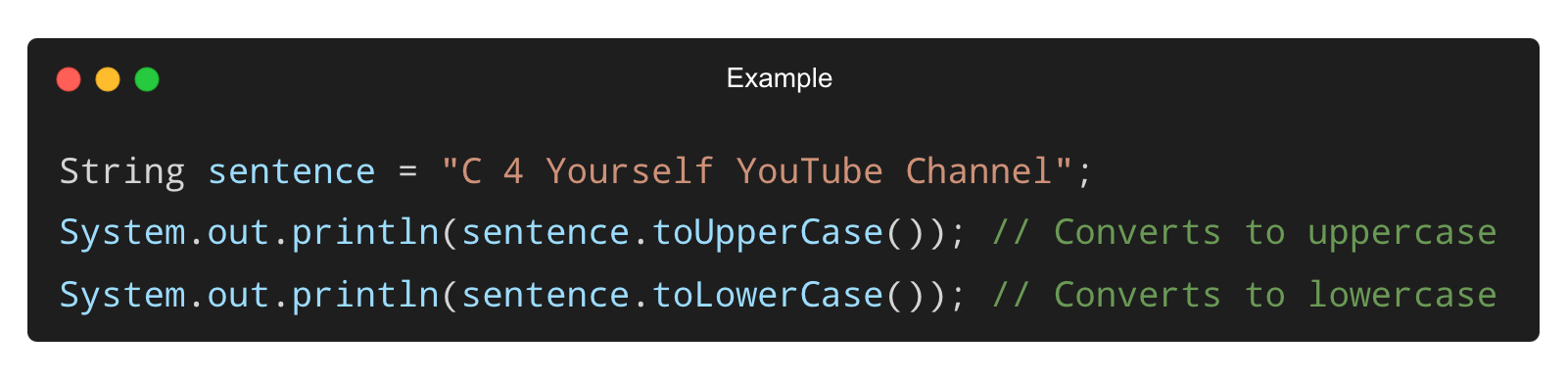
Modifying Strings – Changing Case
Convert to Uppercase and Lowercase:
Output:
C 4 YOURSELF YOUTUBE CHANNEL
c 4 yourself youtube channel

Slide 5
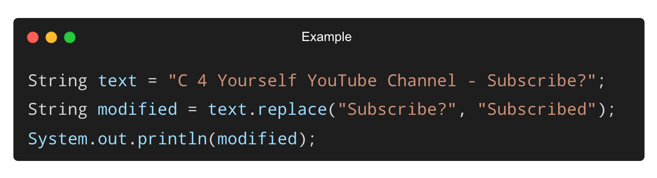
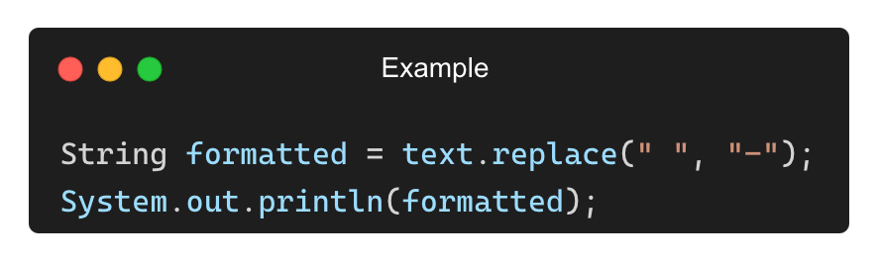
Replacing Characters in a String
Using replace() Method:
Output: C 4 Yourself YouTube Channel - Subscribed
Replacing Spaces with Dashes:
Output:
C-4-Yourself-YouTube-Channel---Subscribe?

Slide 6
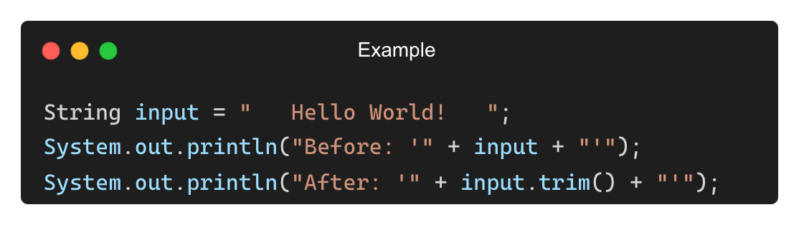
Removing Extra Spaces from a String
Using trim() Method:
Output:
Before: ' Hello World! '
After: 'Hello World!'

Slide 7
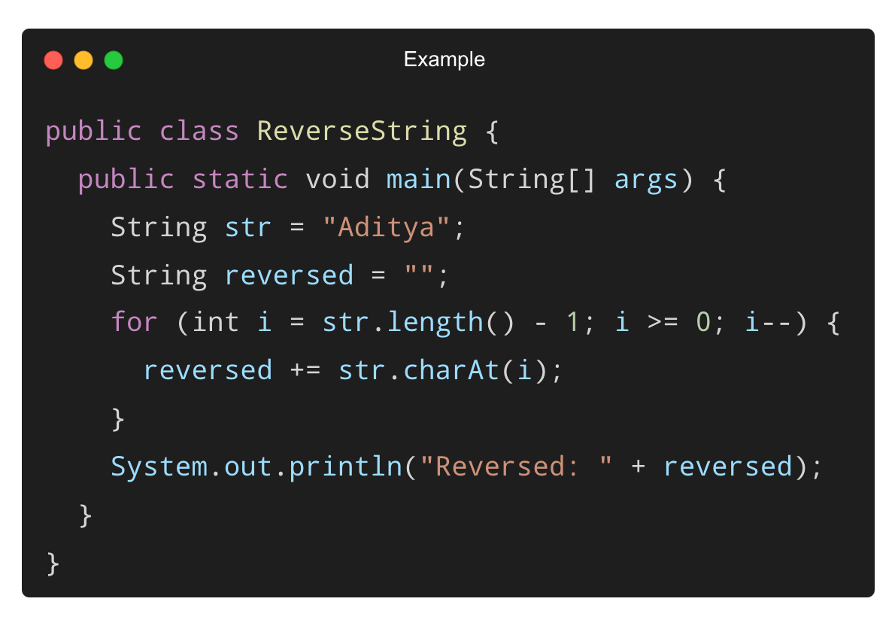
Reversing a String Using a Loop
Output:
Reversed: aytidA

Slide 8
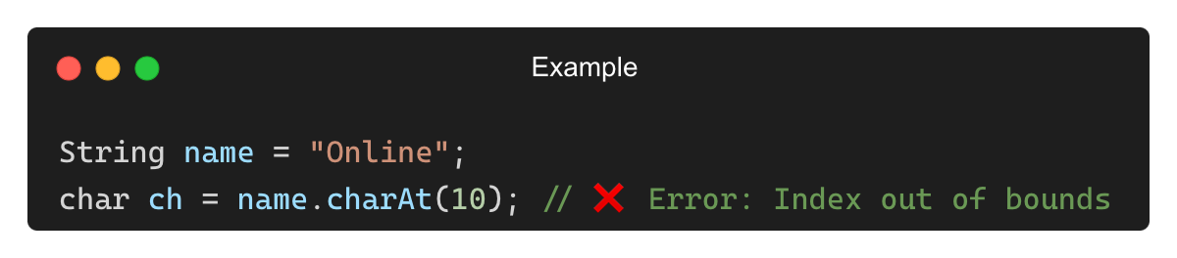
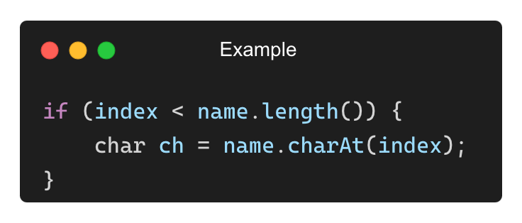
Common Mistakes in String Extraction and Modification
❌ Accessing Index Out of Bounds (StringIndexOutOfBoundsException)
✅ Solution:

Slide 9
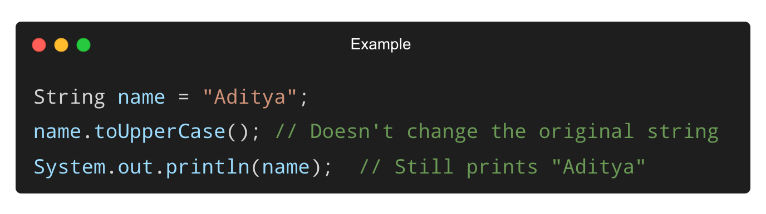
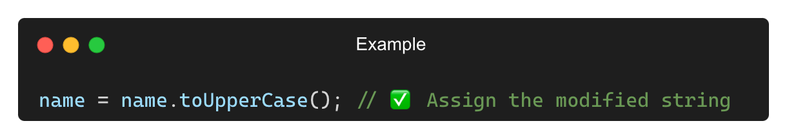
Common Mistakes in String Extraction and Modification (Contd.)
❌ Forgetting to Assign Modified Strings
✅ Solution:

Slide 10
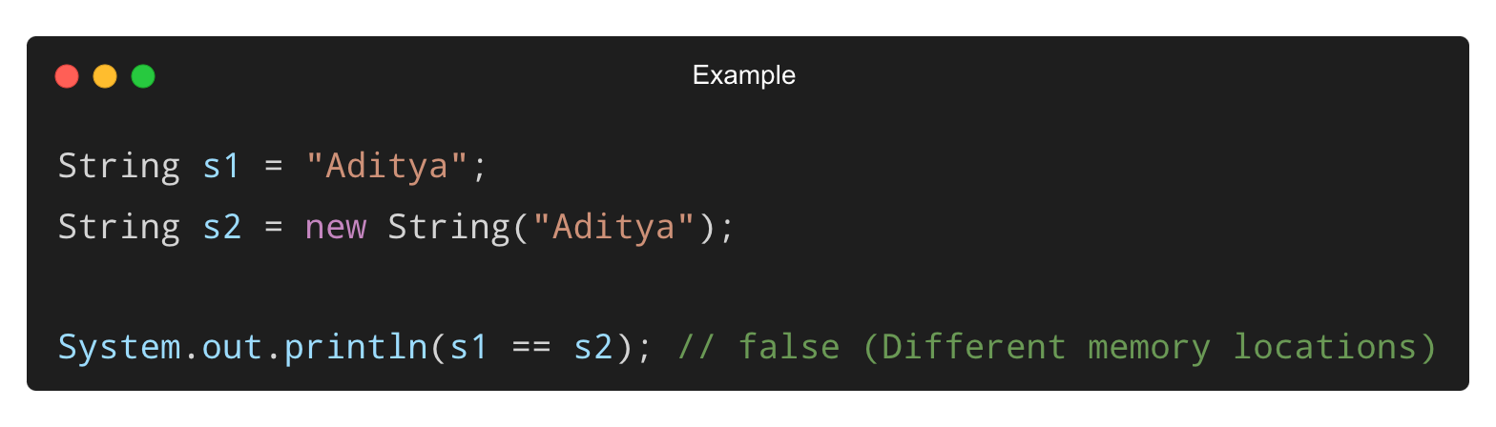
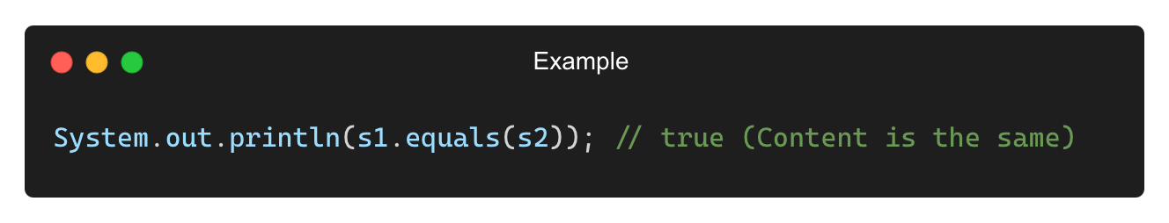
Comparing Strings Using == vs equals()
Using == (Compares Memory References, Not Values):
Using .equals() (Compares Actual Values):
Output: false
true

Slide 11
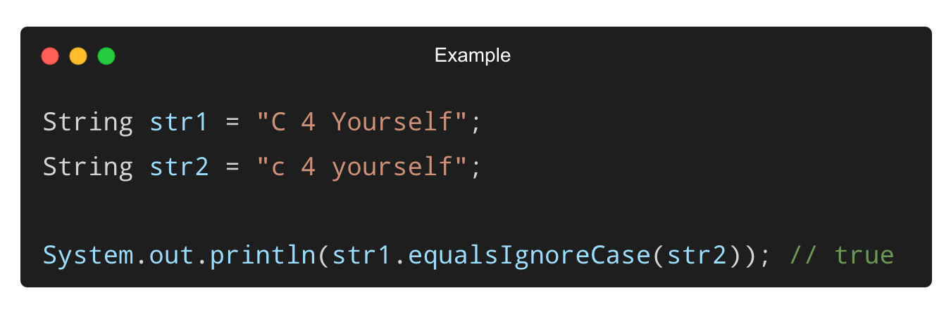
Case-Insensitive Comparison
Using equalsIgnoreCase() for case-insensitive comparison:

Slide 12
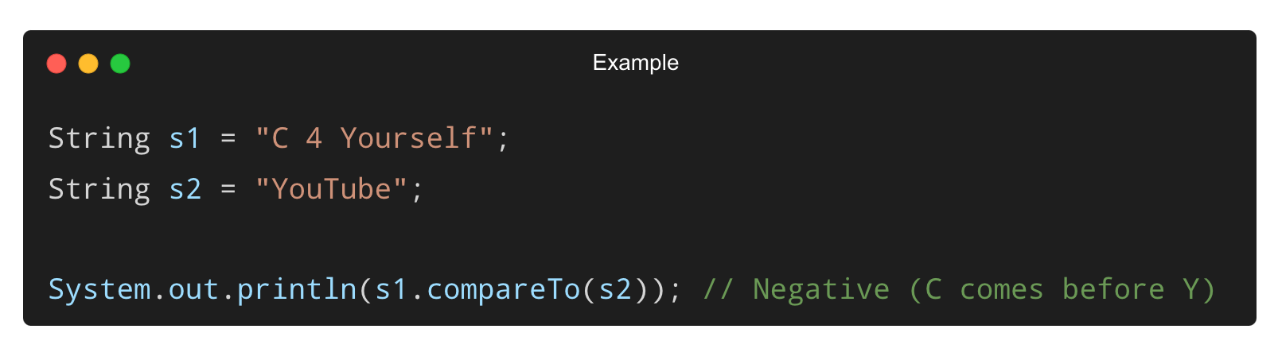
Comparing Strings Lexicographically (compareTo())
Returns:
0 → Strings are equal
< 0 → First string comes before the second
> 0 → First string comes after the second
Output: -22

Slide 13
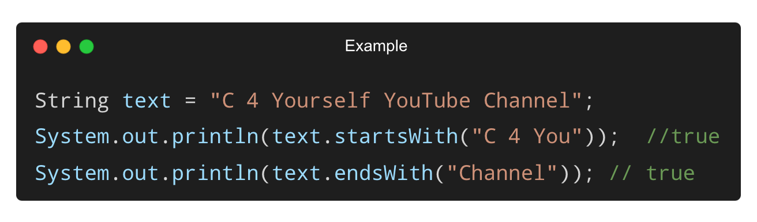
Checking if a String Starts or Ends with a Specific Text
Using startsWith() and endsWith() Methods:

Slide 14
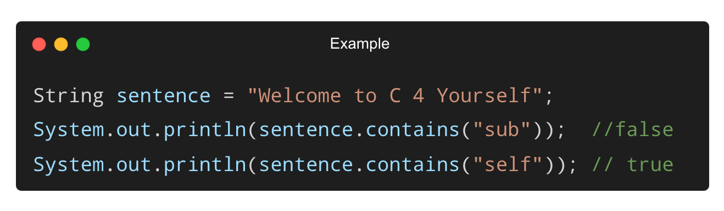
Searching for a Substring Using contains()

Slide 15
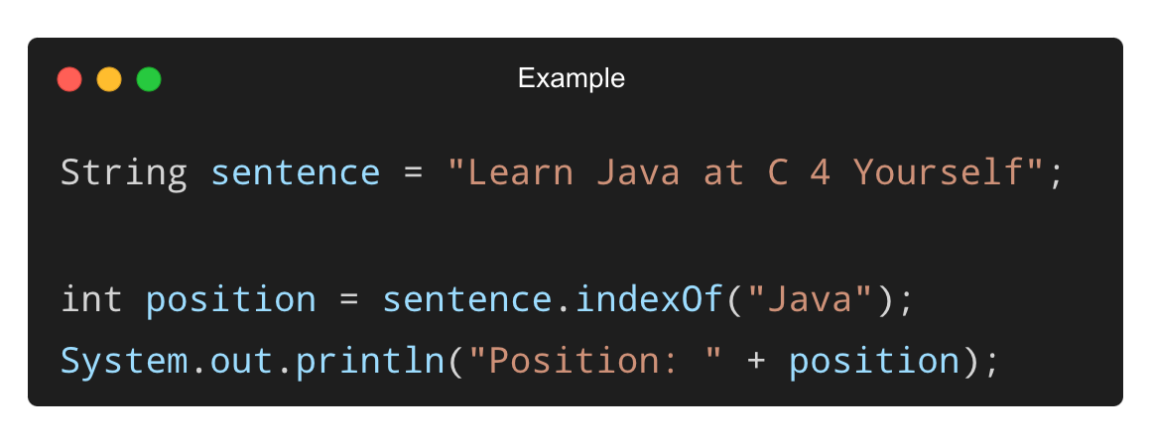
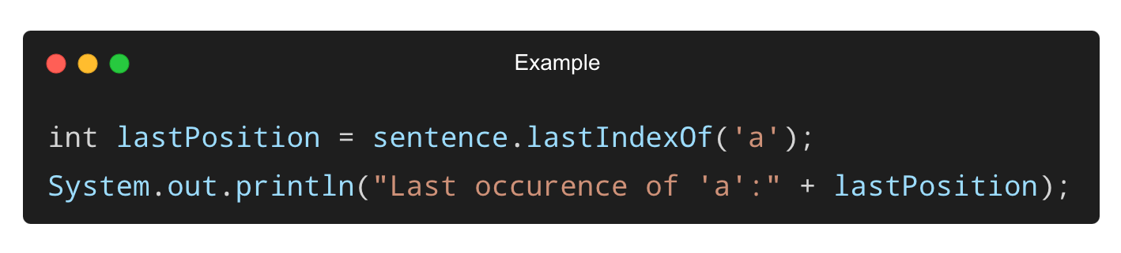
Finding the Position of a Substring (indexOf() & lastIndexOf())
Finding the first occurrence of a word:
Output:
Position: 6
Last occurrence of 'a’: 11
Finding the last occurrence of a character:

Slide 16
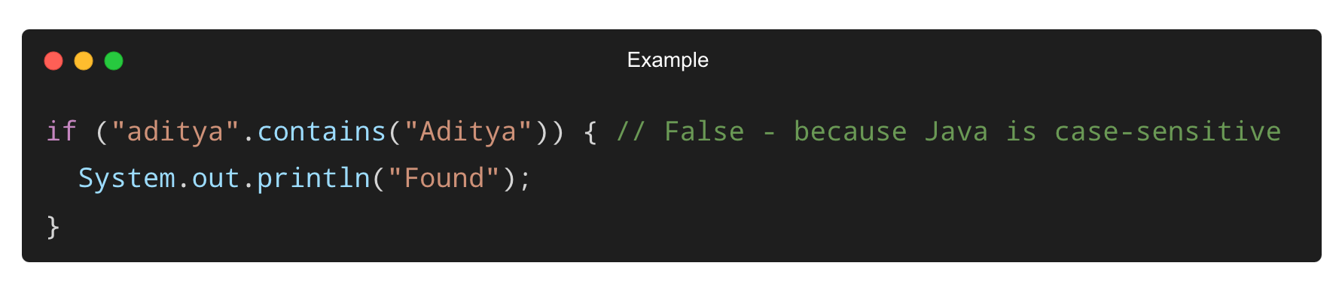
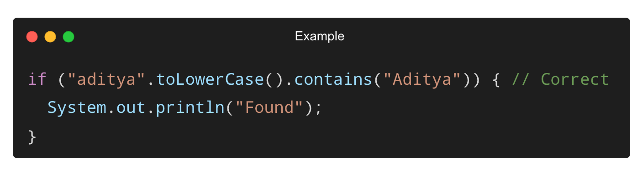
Common Mistakes with String Comparison and Searching (Contd.)
❌ Not Handling Case Sensitivity Properly
✅ Solution:

Slide 17
THANK YOU

